Slide 1
PL-600 Analytics and Artificial Intelligence

Slide 2
Agenda
Planning and evaluating requirements
Operational reporting
Power BI
Enterprise BI
Pre-built insights and custom AI

Slide 3
Solution Architect’s role
Evaluate need from requirements and identify the best approach
Ensure data model supports requirements
Look for opportunity to use proactive insights/AI instead of reactive reviewing of reports and analytics

Slide 4
When do we consider reporting and analytics?
Initiate
Design
Implement
Analyze
Deploy
Notes:
Dazzle with reporting to win the deal in pre-sales/sales
Analyze we must clarify the actual goal of the reporting and analytics
Data modeling must incorporate required data to support
Deploy must include training and setting up for self-service

Slide 5
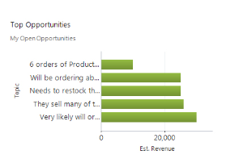
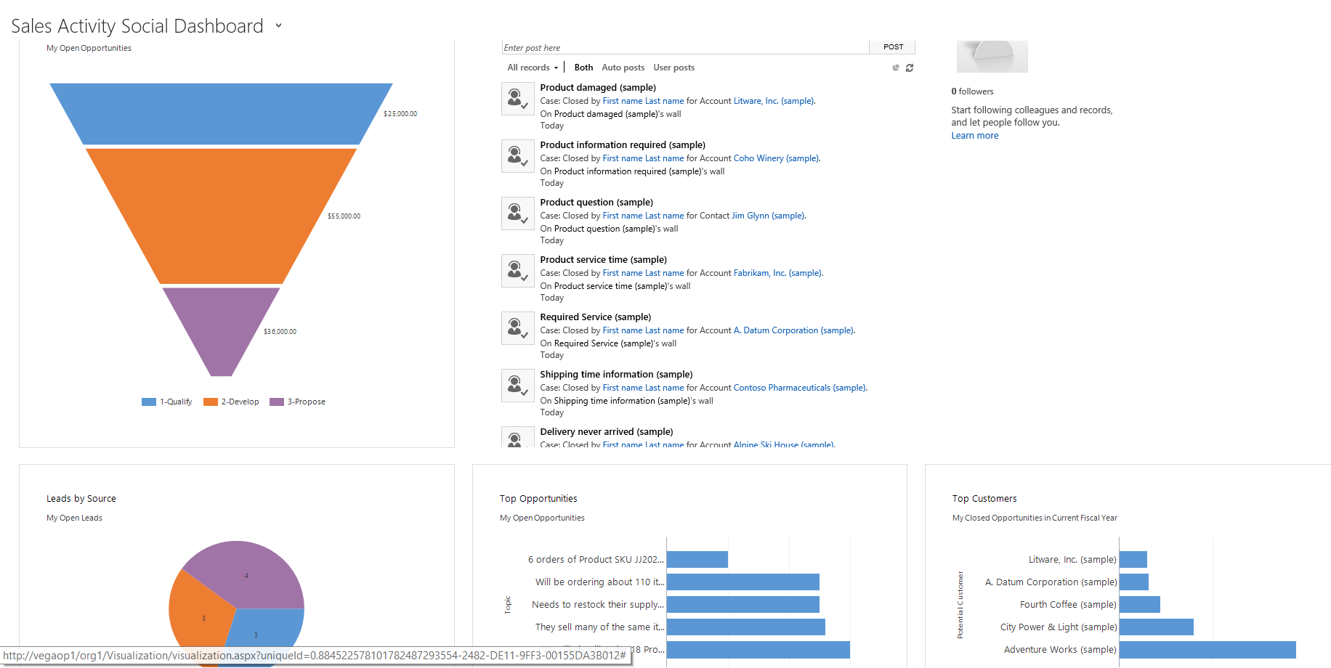
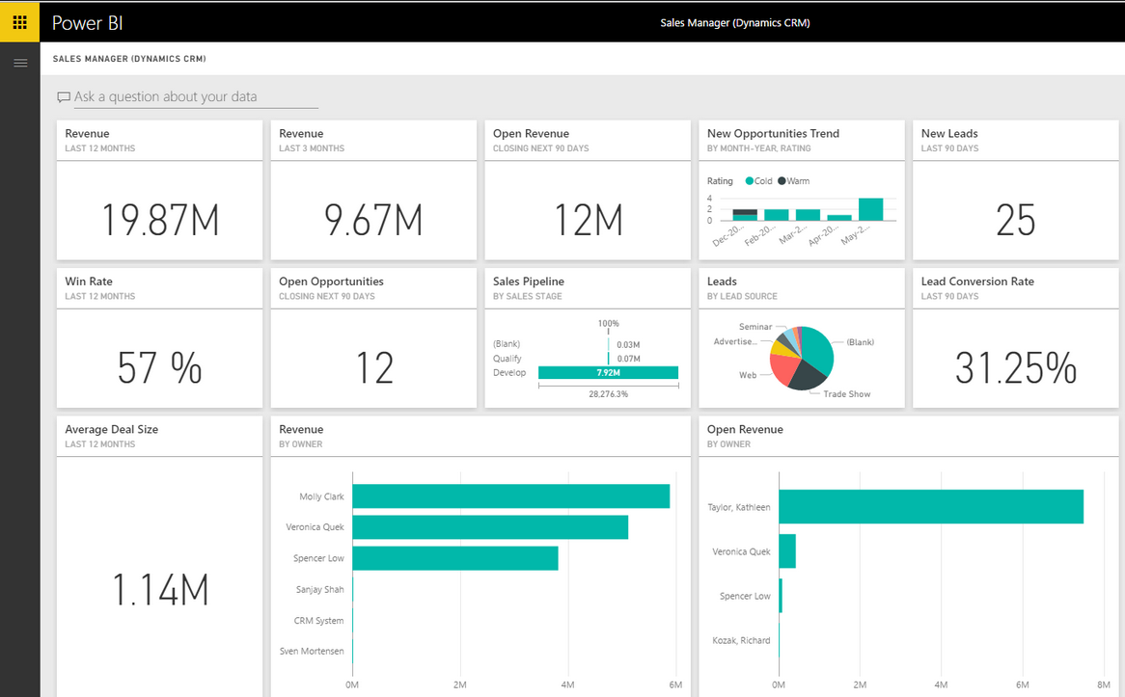
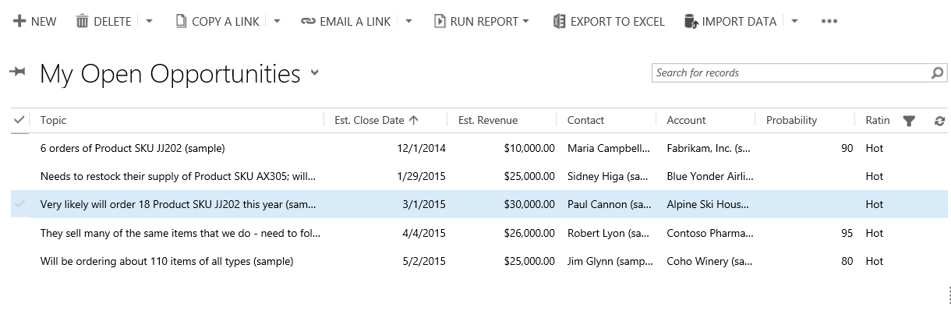









Reporting and Analytics Overview
Operational
Reporting
Views
Charts
Dashboards
SSRS Reports
Embedding of Power BI
Self-service BI
Manual Export to Excel
Power BI Service
Refresh from OData
Enterprise BI
Data Export Service Microsoft Dataverse to Azure SQL
Web APIs for ETL
Microsoft Dataverse to ADLS
Notes:
Operational reporting – Data comes from Microsoft Dataverse directly, viewed and interacted with in the context of the Power App
Self-service BI – Data is exported from Microsoft Dataverse or could be refreshed on a schedule
Enterprise BI – Data is extracted for use in broader enterprise reporting tools, this could be done to allow integration of data from other sources

Slide 6
Considerations
What data is required?
Is there data required that is external to our solution?
Does the requirement fit with one of the pre-built insights?
Who consumes the report/visualization and are they users already?
How fresh does the data have to be or does it need to be a point in time?
Do we need to build something, or can an existing view or report satisfy the requirement?
What is the expected action users will take from reviewing the report?
Is the action something we can predict, or automate instead?

Slide 7
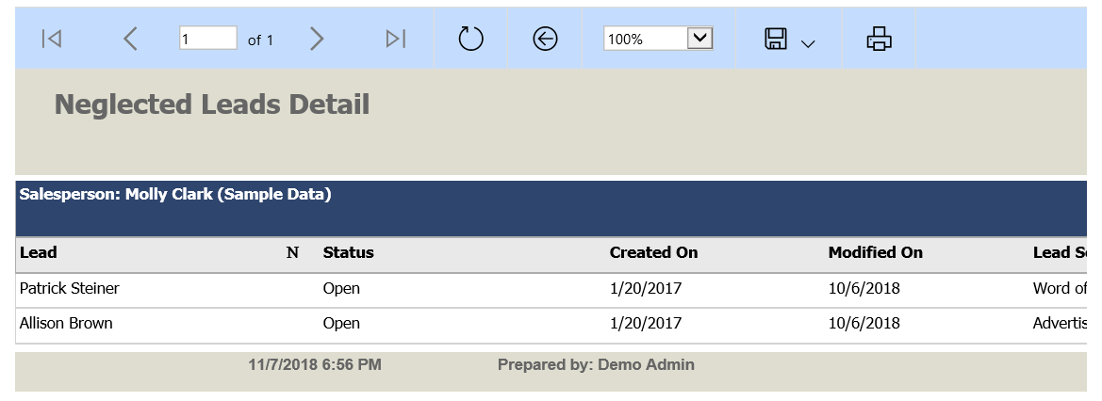
Built in platform options
Advantages
Disadvantages
Views
Dashboards
Charts
Excel
Tabular/report wizard
Easy access from within app
Standard skills required
Data is always current
Security model enforced
Included in solution
Simple visualizations
Only standard filtering
No historical data
Must be app users

Slide 8
Other alternatives
Advanced Find
Immersive Excel
Word and Excel templates
Personal charts and dashboards
Power BI
3rd party reporting tools
Notes:
Creating a report is not always needed.
For ad hock reporting consider using a combination of Advanced Find and Excel
For users, consider using out of the box Dashboards and Charts
For reporting to be printed or exported consider creating Word Templates and Excel Templates for your users.

Slide 9
Power BI Embedded and Standalone

Slide 10
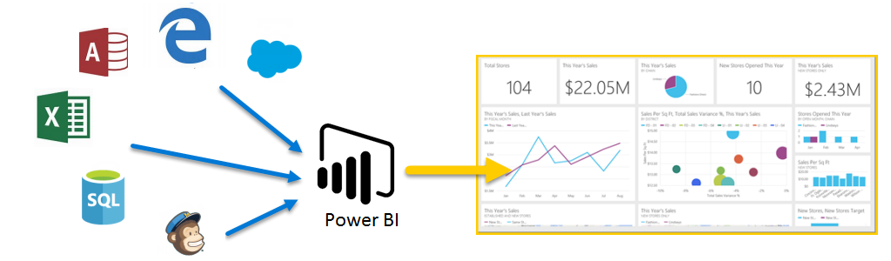
Power BI Overview
Self-service platform to discover/analyze/visualize data and share/collaborate insights with colleagues
Visualizations are interactive and scalable reports, based on collections of different data sources
Notes:
Power BI is a self-service platform allowing users to interact with premade reports and create their own visualizations.
A key advantage of Power BI is the ability to include many data sources as illustrated in the example above.
Salesforce, Edge (tables on the internet), Access, Excel, SQL databases and Mailchimp.
And of course, Dynamics 365

Slide 11
Working with Microsoft Dataverse Data
Connect to a Microsoft Dataverse data source
Clean and transform the data (data modeling)
Select the right tables
Select the right columns
Set fields as the right data type
Filter data
Set table structure and manage relationships
Use DAX (Data Analysis Expressions)
Why are cleanup and transformation required?
Notes:
These are the areas that need attention when it comes to using Microsoft Dataverse data.
So everything is in context of using Microsoft Dataverse data.
Cleanup / transforms – make it easier to consume the data
Column Names
Choices
Lookup data
Dates

Slide 12
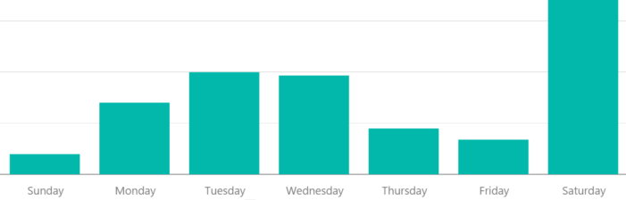
Working with Dates in Power BI
Microsoft Dataverse dates are in Coordinated Universal Time (UTC)
Standard – use dates as is
Advanced – add a calendar table and link to date fields
More options for slicing and sorting data according to dates
More options for using DAX date formulas (YTD)
Also used in content packs from Microsoft

Slide 13
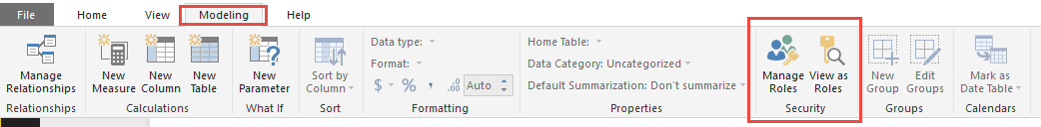
What is Row Level Security?
Different levels of access for different users to the same content
Based on DAX formulas
Security logic is applied at “Row Level”, or “Record Level”
RLS is a True/False DAX evaluation for each row
RLS is never applied on report owner or workspace admins

Slide 14
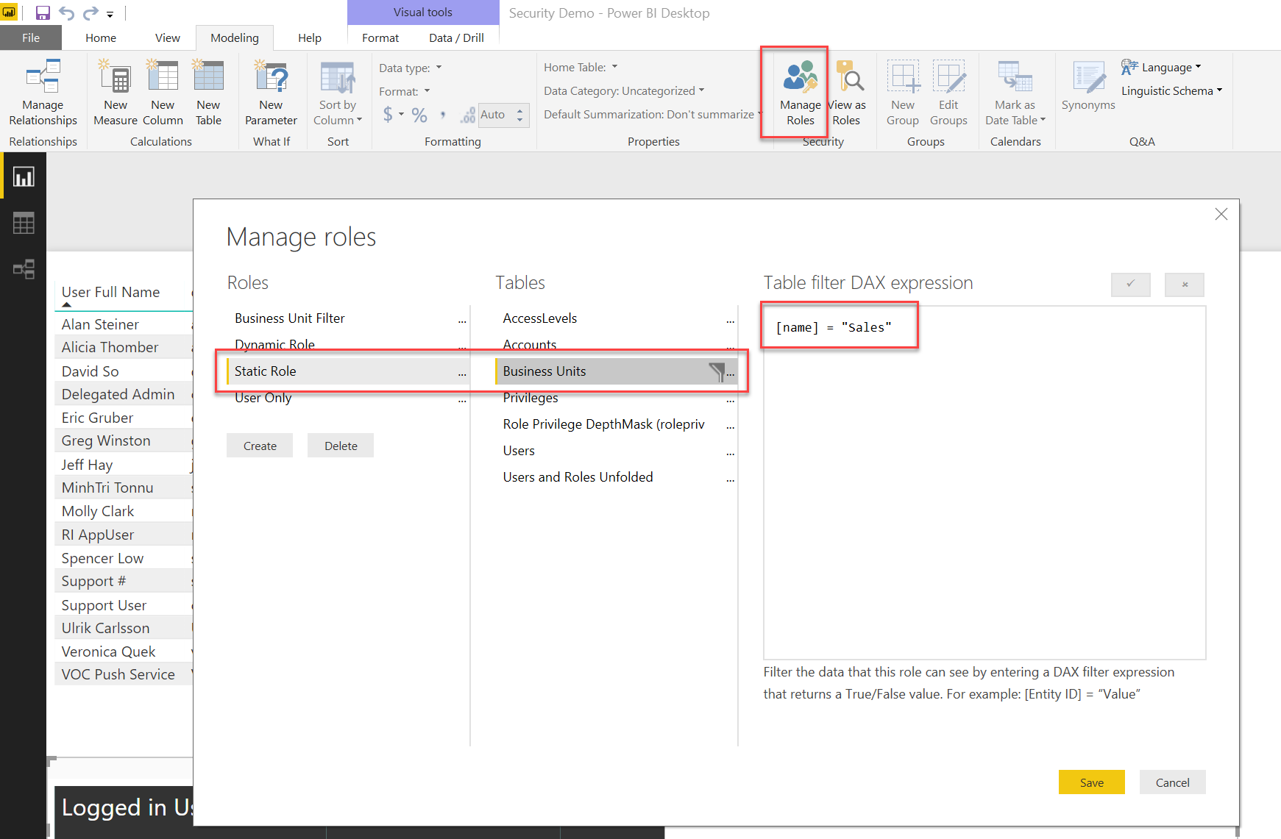
Row Level Security

Slide 15
Options for consuming Power BI
Embedded in Power Apps (model-driven and canvas)
Embedded in Microsoft Teams
From PowerBI.com
From Power BI mobile
From Power BI Data Alerts

Slide 16
Enterprise BI

Slide 17
Enabling enterprise BI
Reduce load on operational data
Allow for transformation and historical analytics
Allow for use with 3rd party reporting tools

Slide 18




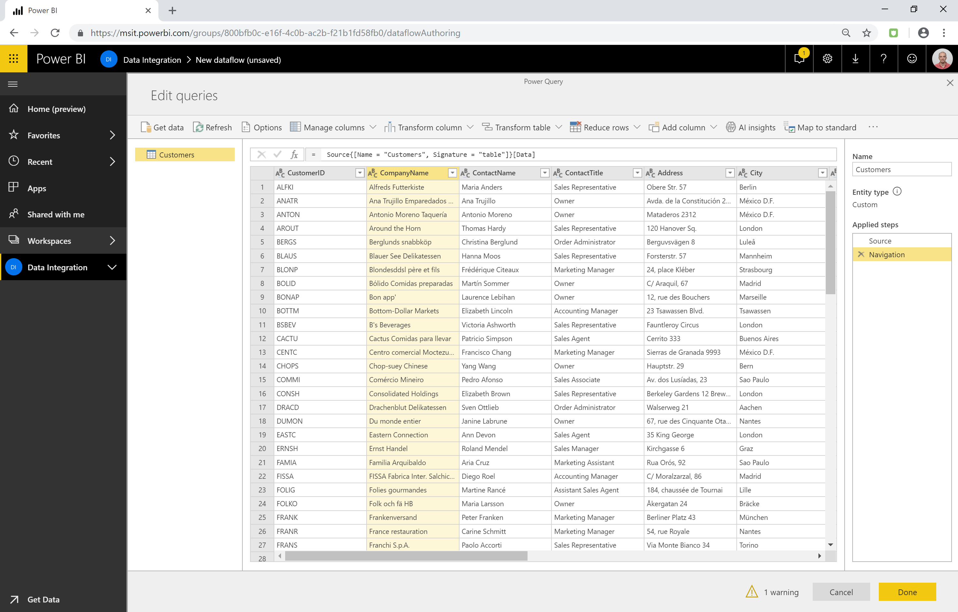





Dataflows – Capabilities in Power BI
Consumption
Authoring
C-ETL
~40 Cloud and On-premises Enterprise data sources
Power BI
Power BI
CDM Folders
Enrich data with Azure ML
and Cognitive Services in PQ
Azure Data Lake
Storage (gen 2)
Customer Insights
Compute
Transform, reshape and mash up data with over 300 different “no-code” data transformations
Other 3rd party tools
Notes:
Must refresh both Dataflow and Dataset

Slide 19


Dynamics 365 – Data Export Service
Replicate Dynamics 365 data to your own Azure data store
Azure SQL, SQL Server on Azure VM
Customer Owned
Azure Subscription
Metadata and data replication
Entity Schema with updates
Full sync and delta sync (push based)
Dynamics 365 (Online)
IT Admin friendly configuration
Data Export Service
Operational visibility and diagnostics
Enterprise grade scalability, reliability and security
Notes:
Can also be used for integration in scenarios where you want to bulk load some input data and join it using SQL queries to filter down to only impacted records

Slide 20
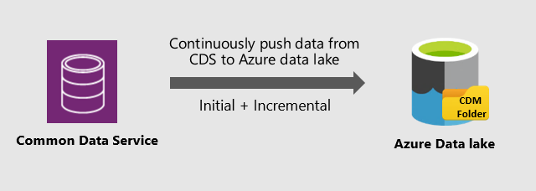
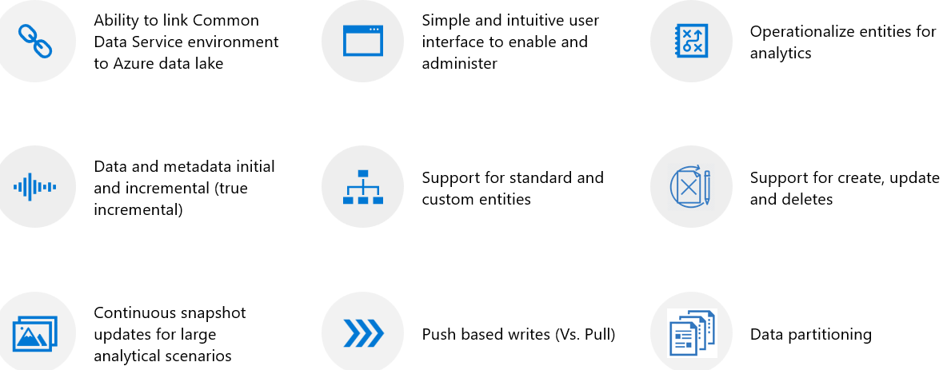
Export Microsoft Dataverse to Azure Data Lake (preview)
Notes:
https://powerapps.microsoft.com/en-us/blog/exporting-cds-data-to-azure-data-lake-preview/

